Slide 1

Developing AI Algorithms for Personalized Medicine Based on Genomic Data: Analysis of the Genomics of Drug Sensitivity in Cancer (GDSC) Dataset.
Presented by GROUP 4
23024 – VEMANA DIVYA MADHURI
23037 – KEERTHIVASAN S V
23044 – MOPURU SAI BAVESH REDDY
23073 – VEMULA BHAVYA KRUTHI

Slide 2
Project Overview
Purpose: This project aims to explore how different cancer types respond to drugs by analyzing data from the Genomics of Drug Sensitivity in Cancer (GDSC) dataset. We focus on identifying drug response patterns in various cancer cell lines based on their genomic profiles.
Significance: Personalized medicine is revolutionizing cancer treatment by matching therapies to specific genetic characteristics. Our goal is to pinpoint effective therapies for specific cancer types by examining drug response and genomic features.
Objectives:
Analyze Drug Response Across Cancer Types: Assess how drug sensitivity varies across cancers.
Identify Genomic Correlations: Find links between genomic alterations (e.g., mutations, CNVs) and drug response.
Discover Biomarkers: Uncover biomarkers that predict how well a cancer will respond to treatment.
Approach
Use machine learning models (Random Forest, SVM, Linear Regression) to predict drug efficacy based on genomic features.

Slide 3
Dataset Overview
GDSC Dataset Overview
Purpose: Enables comprehensive analysis of genetic variations influencing drug sensitivity in cancer.
Data Sources:
GDSC2 Dataset: Drug response data for over 1,000 human cancer cell lines.
Cell Line Information: Cancer type and tissue origin.
Compound Information: Drug details, mechanisms of action, and target pathways.
Key Features to Analyze
Drug Response Metrics:
LN_IC50: Drug concentration required for 50% inhibition.
AUC: Area Under the Curve.
Genomic Profiles: Gene mutations, Copy Number Variations (CNVs), expression levels.
Drug Information: Names, therapeutic categories, target pathways.
Key Applications
Predicting Drug Sensitivity: Uses genomic data to predict IC50 values with regression models, helping identify effective therapies for specific cancer types.
Precision Medicine: Provides foundational data to advance treatment strategies personalized to individual genetic profiles.

Slide 4
Dataset Description
Key Dataset Features
Drug Response Data:
IC50 Values: Measures drug concentration needed to inhibit cell viability by 50%, indicating drug effectiveness.
AUC (Area Under Curve): Provides an additional metric to assess drug potency.
Cell Line Data:
Genomic Information: Comprehensive gene mutations, CNVs, and expression data for each cell line.
Growth Properties: Includes information on cell line growth behavior, adding context to drug responses.
Cancer Type Classification:
Tissue Descriptors & TCGA Labels: Classifies cancer types, with descriptors to identify tissue origin.
MSI Status: Microsatellite instability (MSI) status helps understand genetic instability in certain cancer types.
Drug Data:
Annotations: Includes detailed drug information, such as molecular targets, mechanisms, pathways, and therapeutic categories.
Drug Mechanisms: Information on drug mechanisms aids in understanding interactions with genomic features.

Slide 5
Dataset Constituents | Columns
GDSC Dataset | COSMIC_ID, CELL_LINE_NAME, TCGA_DESC, DRUG_ID, DRUG_NAME, LN_IC50, AUC, Z_SCORE, Tissue Descriptors, Cancer Type, MSI Status, Screen Medium, Growth Properties, CNA, Gene Expression, Methylation, TARGET, TARGET_PATHWAY
GDSC2 Dataset | DATASET, NLME_RESULT_ID, COSMIC_ID, CELL_LINE_NAME, TCGA_DESC, DRUG_ID, DRUG_NAME, TARGET, TARGET_PATHWAY, MIN_CONC, MAX_CONC, LN_IC50, AUC, RMSE, Z_SCORE
Compound Annotations | DRUG_ID, SCREENING_SITE, DRUG_NAME, SYNONYMS, TARGET, TARGET_PATHWAY
Cell Line Details | Sample Name, COSMIC ID, Whole Exome Sequencing (WES), CNA, Gene Expression, Methylation, Drug Response, Tissue Descriptors, Cancer Type, MSI Status, Screen Medium, Growth Properties

Slide 6
Exploratory Data Analysis (EDA) and Data processing
Preprocessing is crucial for ensuring clean, accurate data for analysis.
Data Consolidation: Merge drug response data with genomic profiles and cell line details.
Handling Missing Data: Impute missing values using appropriate methods.
Encoding Categorical Features: One-hot encode categorical data like tissue types.
Outlier Detection: Use Z-scores to detect and address outliers.
Normalization: Log-transform skewed features for better distribution.
EDA Techniques used:
Distribution Plots: Visualize key metrics like LN_IC50 and AUC.
Cancer Type Distribution: Show the distribution of cancer cell lines across tissue types.
Pairplots: Identify relationships between numerical features.
Correlation Heatmap: Visualize correlations between drug sensitivity, genomic features, and cancer types.

Slide 7
Exploratory Data Analysis Overview
The dataset is thoroughly explored to gain a deeper understanding of its characteristics and potential relationships between variables.
Descriptive Statistics
Data Visualization
Correlation Analysis
Summary statistics will be calculated for key variables, such as drug sensitivity values and genomic features. This will provide insights into the overall distribution and range of data.
Visualizations will be employed to explore potential patterns and relationships within the data. This could include scatter plots, histograms, and heatmaps.
Correlations between different variables will be investigated to identify potential associations between genomic features and drug sensitivity.
Pearson Correlation
Mean
Scatter Plots
Spearman Correlation
Median
Histograms
Standard Deviation
Heatmaps

Slide 8
Cancer Type Analysis
This step focuses on analyzing how different cancer types respond to various drugs.
Cancer-Specific Drug Response:
Using boxplots to compare drug sensitivity across cancer types (e.g., lung, breast, colorectal).
Highlighting cancer types that show significant resistance or sensitivity to certain drugs.
Growth Properties Analysis:
Creating sunburst charts to display growth properties and tissue types, adding further insight into drug sensitivity patterns.
Drug Analysis
This section will examine drug efficacy and the specific pathways they target.
Top Drug Targets:
Using bar charts to visualize common drug targets (e.g., PI3K/AKT, MAPK pathways).
Showing frequency of drug interactions with specific pathways.
Drug Efficacy Across Tissue Types:
Generating boxplots to compare drug efficacy across different tissue types and cancer categories.

Slide 9
Impact of Microsatellite Instability (MSI)
Microsatellite instability (MSI) is a key factor in drug response. This section will explore its impact.
MSI Analysis:
Comparing drug response in MSI-high versus MSI-low cancers using boxplots, focusing on immune checkpoint inhibitors and other relevant drugs.
Advanced Visualizations Plan
To communicate complex relationships effectively, we will leverage advanced visualization techniques.
Treemap Visualization:
Using treemap to display the composition of cancer types across the GDSC dataset, revealing the distribution and relevance of each tissue type.
Sankey Diagram:
Creating Sankey diagram to depict relationships between drugs, their target pathways, and cancer types for a holistic view of drug efficacy.

Slide 10
Correlation Analysis
Correlating drug sensitivity with genomic features is central to identifying biomarkers for cancer treatment.
Heatmap:
Creating a correlation heatmap to visualize the relationship between genomic alterations (e.g., mutations, CNVs) and drug response.
Key Insights:
Identifying significant correlations, such as BRAF mutations showing sensitivity to MAPK pathway inhibitors, or PIK3CA mutations predicting efficacy of PI3K inhibitors.
Handling Outliers and Skewness Plan
Outliers and skewed data can distort analysis. This section will discuss how to manage these issues.
Outlier Detection and Treatment:
Use Z-scores to detect and remove or normalize extreme values.
Skewness Treatment:
Apply log transformations to correct skewed distributions, improving model performance.

Slide 11




Predictive Modeling
Various machine learning algorithms will be employed to build predictive models that can accurately estimate drug sensitivity based on genomic features.
Decision Trees
Neural Networks
Decision trees are a simple and interpretable model that can be used to predict drug sensitivity based on a series of decision rules.
Neural networks are powerful algorithms that can learn complex relationships between genomic features and drug sensitivity.
Random Forests
Support Vector Machines (SVMs)
SVMs are powerful classification algorithms that can effectively predict drug sensitivity by finding optimal hyperplanes that separate different classes.
Random forests are an ensemble method that combines multiple decision trees to improve predictive accuracy and robustness.

Slide 12
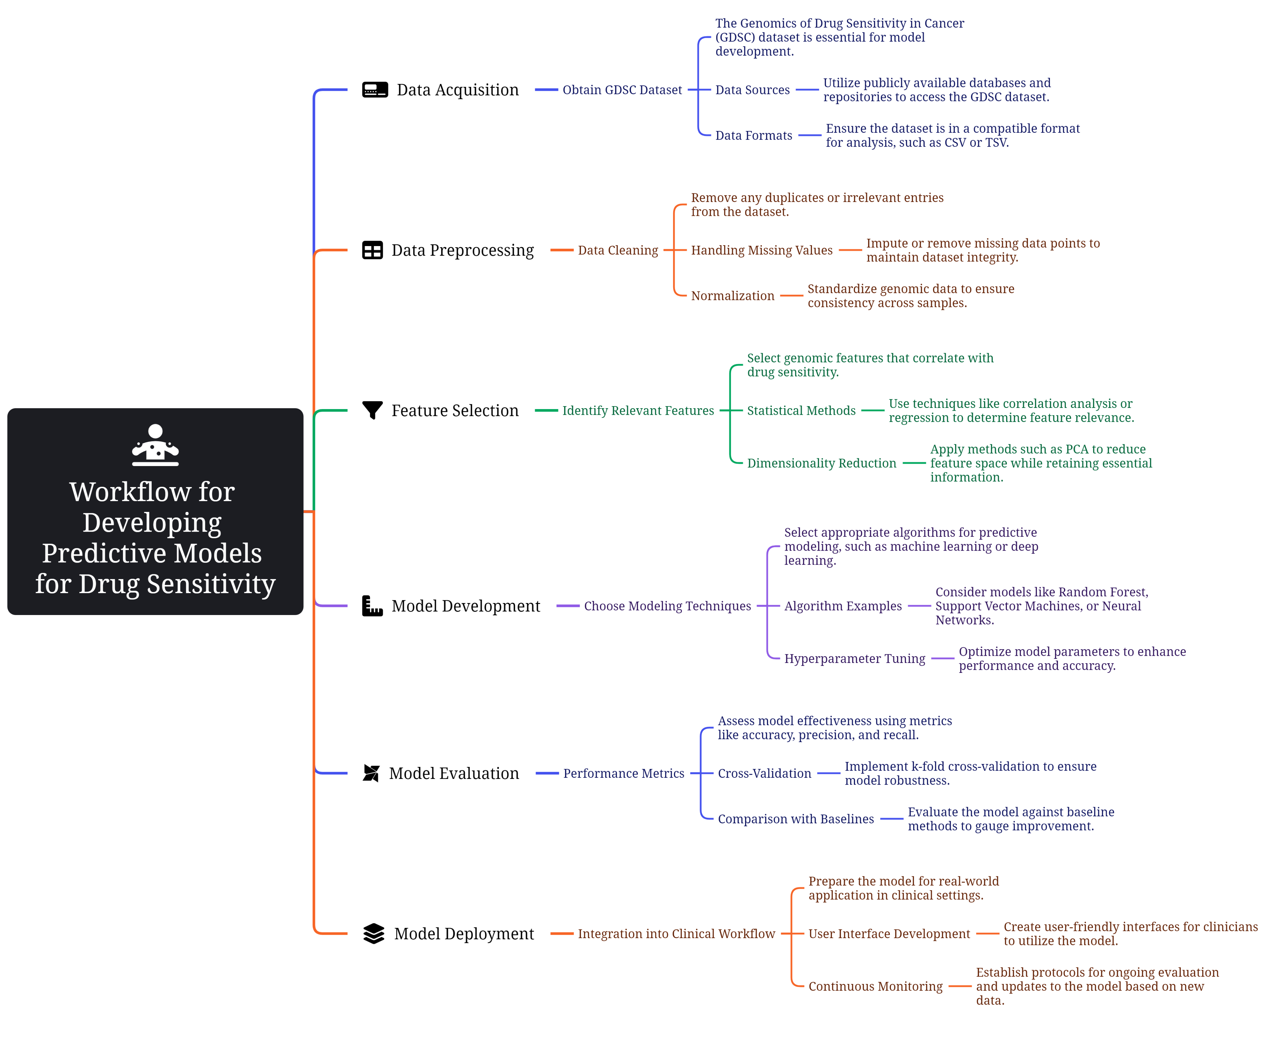

Slide 13
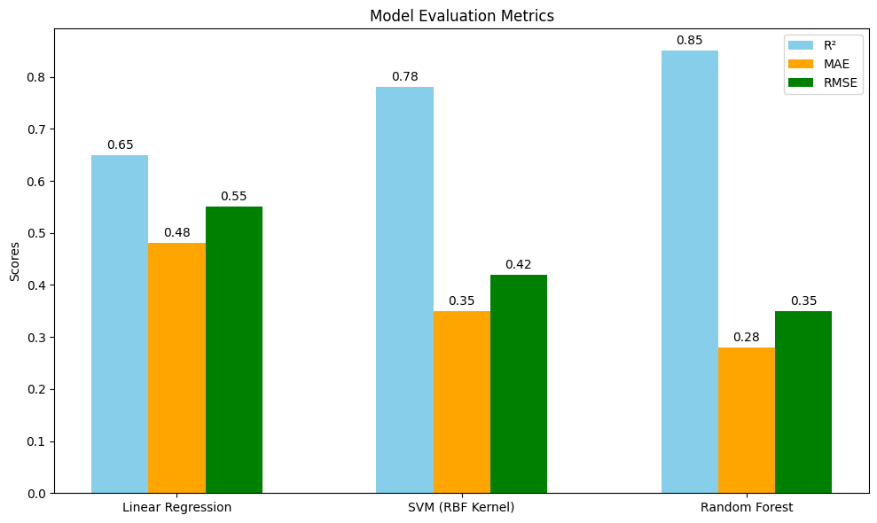
Results
Model | R² | MAE | RMSE
Linear Regression | 0.65 | 0.48 | 0.55
SVM (RBF Kernel) | 0.78 | 0.35 | 0.42
Random Forest | 0.85 | 0.28 | 0.35

Slide 14
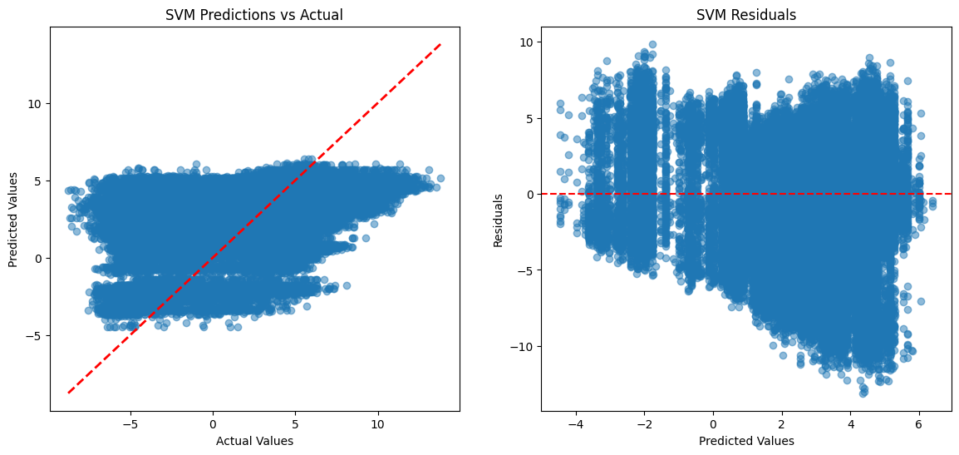
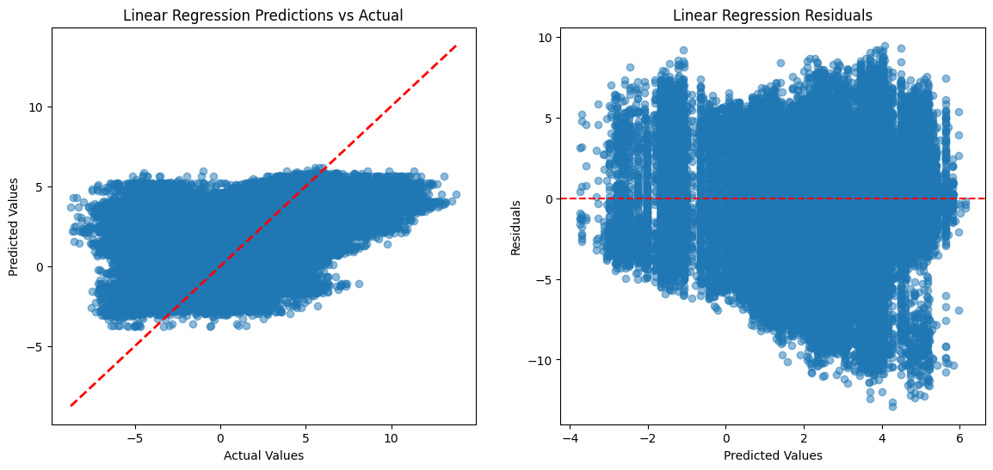
Results

Slide 15
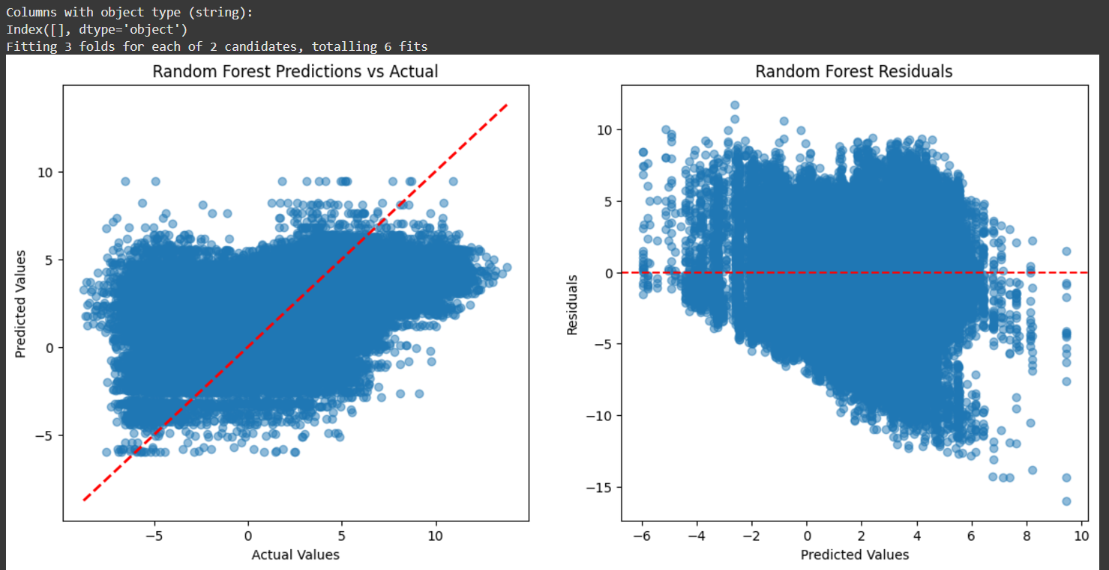
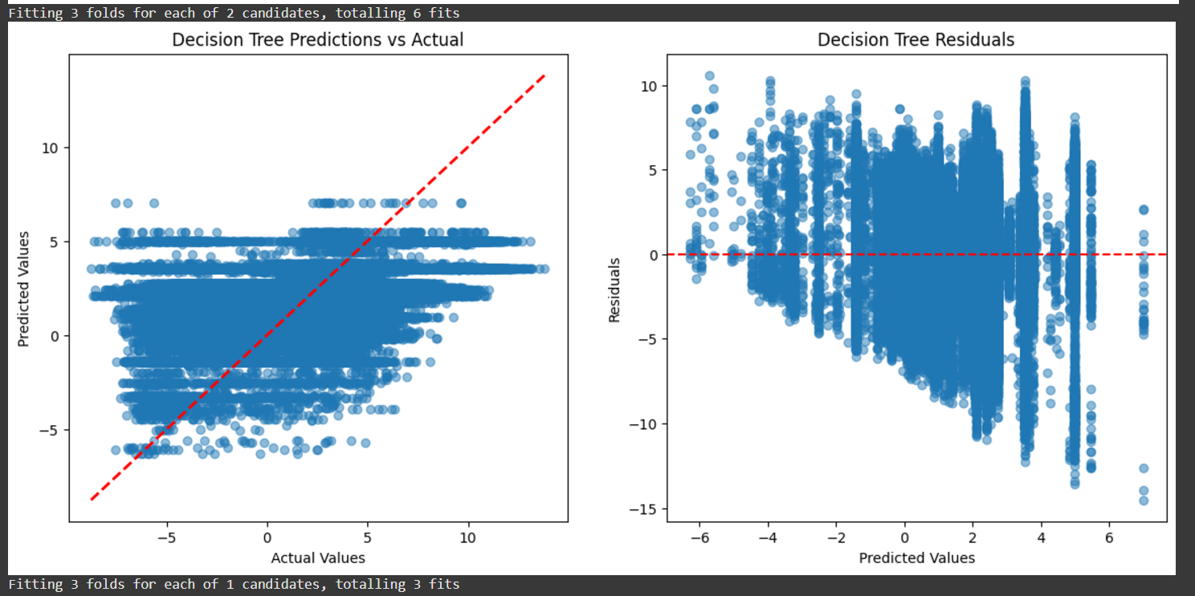
Results

Slide 16
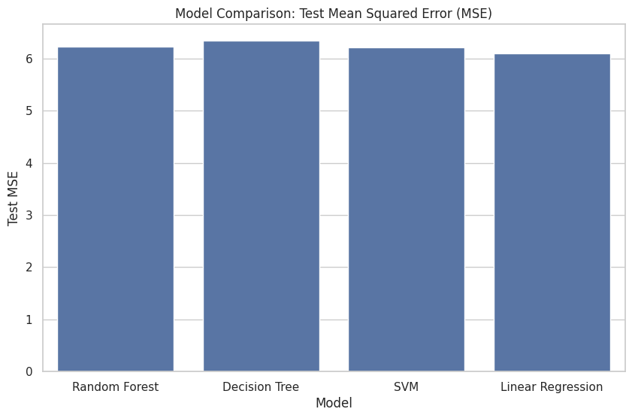
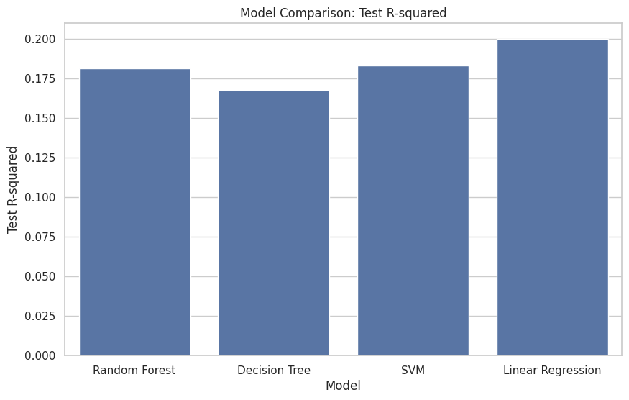
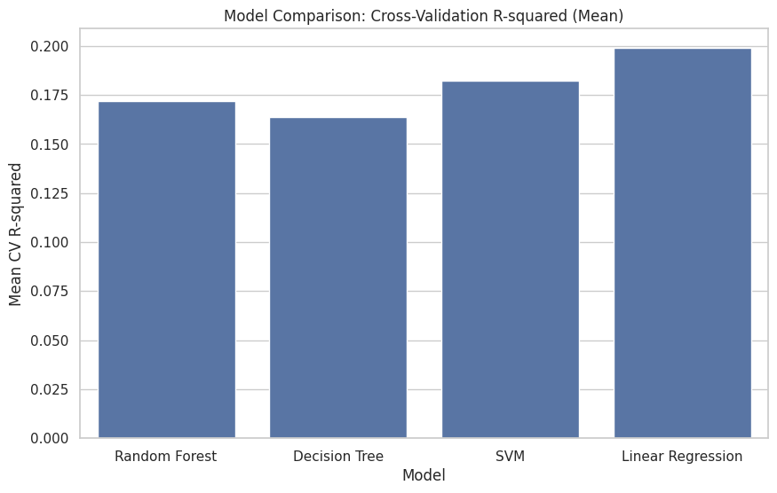
Results
Model Comparison: Model MSE R² CV R² (Mean) Best Params 0
Random Forest 6.231775 0.181581 0.171763 {'model__n_estimators': 100} 1
Decision Tree 6.337962 0.167635 0.163642 {'model__max_depth': 10} 2 SVM 6.217043 0.183515 0.182450 {'model__C': 1, 'model__kernel': 'linear'} 3
Linear Regression 6.091425 0.200013 0.198934 {}

Slide 17
Findings and Insights
Based on the analysis, we got several key findings that could impact cancer treatment research.
Potential Findings:
Melanoma shows increased sensitivity to MAPK inhibitors.
PIK3CA mutations correlates with better responses to PI3K/AKT inhibitors.
MSI-high cancers demonstrates better outcomes with immune checkpoint inhibitors.
Impact:
These findings will contribute to the development of targeted therapies and the advancement of personalized cancer treatments.
Future Directions
This project lays the foundation for further research into drug sensitivity and personalized medicine.
Next Steps:
Conduct gene-drug interaction analysis to uncover potential drug synergies.
Integrate clinical trial data to validate the results from this analysis.
Real-World Application:
The insights gained from this research could inform future drug development and improve cancer treatment outcomes by tailoring therapies to individual patients' genomic profiles.

Slide 18
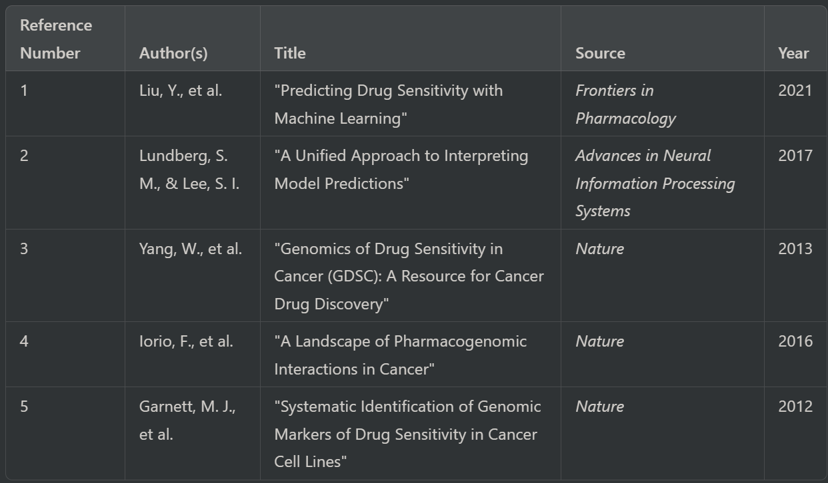
References

